Slide 1


SHIVAM PANDEY
02/09/2021

Slide 2

Outline
Executive Summary
Introduction
Methodology
Results
Conclusion
Appendix

Slide 3
Executive Summary
In this project we were provided with the data for different flights of SpaceX with a goal to analyze about the factors that affected the successful landing of the first stage of the falcon 9 rockets.
We used the SpaceX API for the data extraction and wrangling.
We performed Exploratory Data analysis on that data to study about the dependence of the outcome of successful landing on a variety of factors like launch site, payload mass, orbit etc.
We found that orbit and payload had a great impact over the outcome wherever the payload mass was high the landing was successful and for orbit GEO,SSO,ES-L1 had highest successful landing rate while GTO had the lowest.
We tested various machine learning data classifiers which predicted the probability of the successful landing.
We found that Support Vector Machine was the most accurate out of all.
GITHUB LINK-https://github.com/shivampandeyvns/IBM-watson/tree/master

Slide 4
Introduction
The space race is on a rapid race, private firms have made space travel available for people. In this race the name SpaceX has outshined all.
SpaceX boasts that falcon 9 had a budget of 65 mil dollar while others has 165 mil. Dollar budget, this is because it can re-use it’s first stage.
In this project we were provided with the data of past landings of SpaceX falcon9, with a goal to build classifier to the predict the probability of successful landing, cause that will help us analyze the bid for the next tender.
We use SpaceX API for data extraction, and we perform EDA and try to build the classifier with the highest accuracy.
GITHUB LINK-> https://github.com/shivampandeyvns/IBM-watson/tree/master

Slide 5


Slide 6
Methodology
Executive Summary
Data collection methodology:
Describe how data was collected
Perform data wrangling
Describe how data was processed
Perform exploratory data analysis (EDA) using visualization and SQL
Perform interactive visual analytics using Folium and Plotly Dash
Perform predictive analysis using classification models
How to build, tune, evaluate classification models

Slide 7
Data Collection
We use the SpaceX API for the data collection. Here we get the information about the rockets, booster Version etc.
On top of that we use the web scrapping library of python named BeautifulSoup for data collection from the Wikipedia.
We then combine the data from several sources into one csv data file for further analysis and operations of our interest.
GITHUB LINK-> https://github.com/shivampandeyvns/IBM-watson/tree/master

Slide 8
Data Collection – SpaceX API
SpaceX_url
Requests.get(SpaceX_ur;)
data=pd.json_normalize(response.json())
Present your data collection with SpaceX REST calls using key phrases and flowcharts
Add the GitHub URL of the completed SpaceX API calls notebook (must include completed code cell and outcome cell), as an external reference and peer-review purpose

Slide 9
Data Collection - Scraping
Define BeautifulSoup object
Providing the URL and using find_all
Using functions to create a Dictionary and then making a dataFrame
Present your web scraping process using key phrases and flowcharts
Add the GitHub URL of the completed web scraping notebook, as an external reference and peer-review purpose

Slide 10
Data Wrangling
For Data Wrangling we used Pandas library of python which provides us with the necessary tools for this process.
We used the info() method for identifying the type of columns and number of data in each column.
We used describe() for mathematical analysis of the data in each column like mean, average, max, min in every column.
Then we used isnull().sum() for the missing values that we need to treat.
GITHUB LINK-> https://github.com/shivampandeyvns/IBM-watson/tree/master

Slide 11
EDA with Data Visualization
Exploratory Data Analysis refers to the process of finding patterns in the data with the help of Data visualization libraries.
We used scatterplot for the study of inter dependence between our target column and other provided columns.
We used Bar chart for the study of various orbits and their success rate.
We used line plot for the study of outcome with years

Slide 12
EDA with SQL
We used several SQL query commands for the sake of EDA.
We used SELECT and FROM for the selection of data.
We used WHERE for the conditional selection.
We used LIMIT to select only a specific amount of data.
We used GROUP BY for the grouping of data.
We used SUM, AVG, COUNT etc. for sum, average and count calculations for various rows.

Slide 13
Build an Interactive Map with Folium
We used circle markers for the marking of various launch sites.
We used popup for the popup select option on the map.
We used cluster marker for the cluster of the data points since they large in number.
We used polyline for the drawing a line from launch sites to the nearest railway station, highway etc.

Slide 14
Build a Dashboard with Plotly Dash
Inside the plotly Dashboard we have provided with the drop-down menu option for the stakeholders to easily modify the values of the plots and observe the change in the trends.
We have used pie chart to show the composition.
We have used the line plot for the trend analysis.
We have bar chart to show the numerical values.

Slide 15
Predictive Analysis (Classification)
We decided to test the accuracy of Logistic Regression, Support Vector Machines, Decision Trees, and K nearest neighbors for the classification algorithm.
We used train test split for the train and test data split.
We then used GridSearchCV for hyperparameter tuning , it provided us with the best parameters for all our algorithms.
We then tested the algorithm on the test set with the best parameters and recorded their accuracy and designed a confusion matrix for each of the algorithms.

Slide 16
Results
Exploratory data analysis results
Interactive analytics demo in screenshots
Predictive analysis results

Slide 17


Slide 18
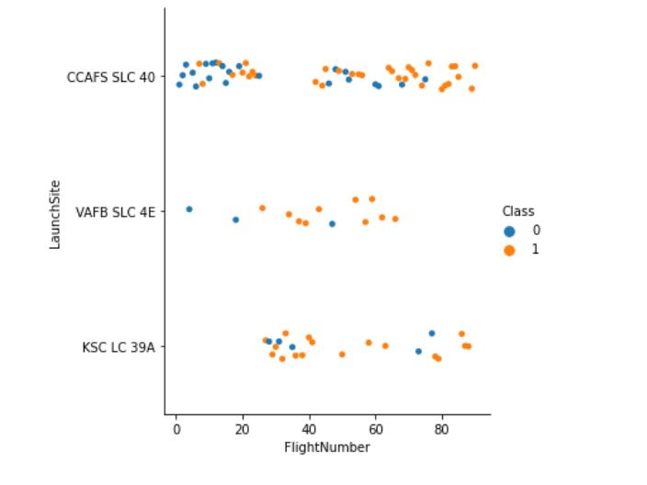
Flight Number vs. Launch Site
Scatter plot of Flight Number vs. Launch Site
CCAFS SLC 40 has most number of flights.

Slide 19
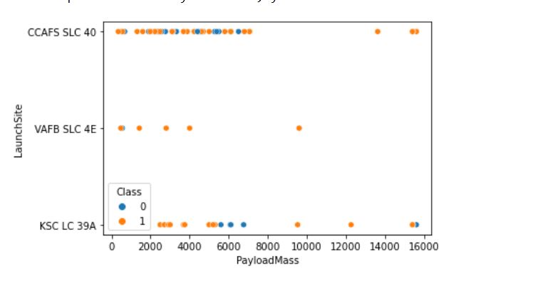
Payload vs. Launch Site
Show a scatter plot of Payload vs. Launch Site
High payload mass results in Successful landing of first stage.

Slide 20
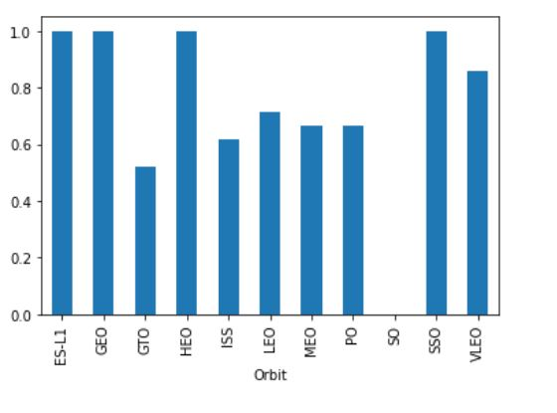
Success Rate vs. Orbit Type
Bar chart for the success rate of each orbit type
GTO is most unfavorable orbit for successful landing.
ES-L1, GEO, SSO, HEO are most favorable orbit for successful landings.

Slide 21
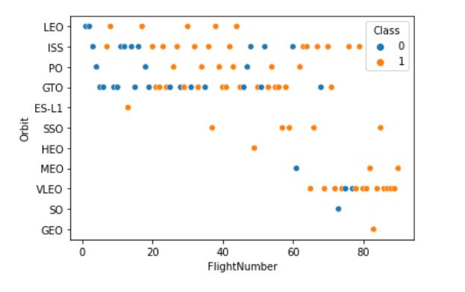
Flight Number vs. Orbit Type
Scatter point of Flight number vs. Orbit type
VLEO has most number of flights.
GTO has most number of unsuccessful flights.

Slide 22
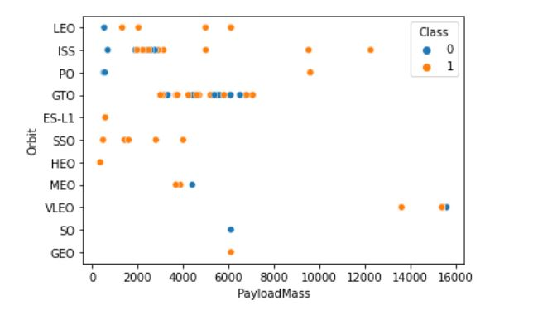
Payload vs. Orbit Type
Scatter point of payload vs. orbit type
GTO is not used for heavy payloads.
VLEO is used for a very specific amount of payload mass.

Slide 23
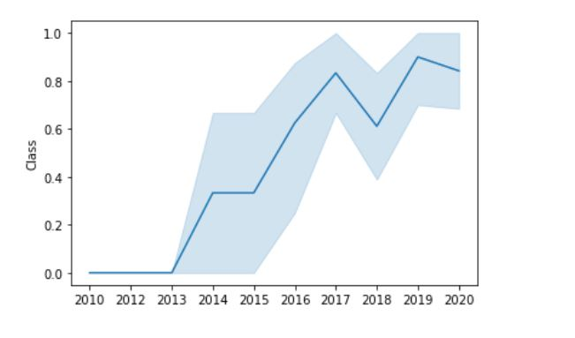
Launch Success Yearly Trend
Line chart of yearly average success rate
The success rate has begun to increase from 2013.
There is a downward spike in Year 2018.

Slide 24

All Launch Site Names
We find that there are 3 unique Launch sites.

Slide 25
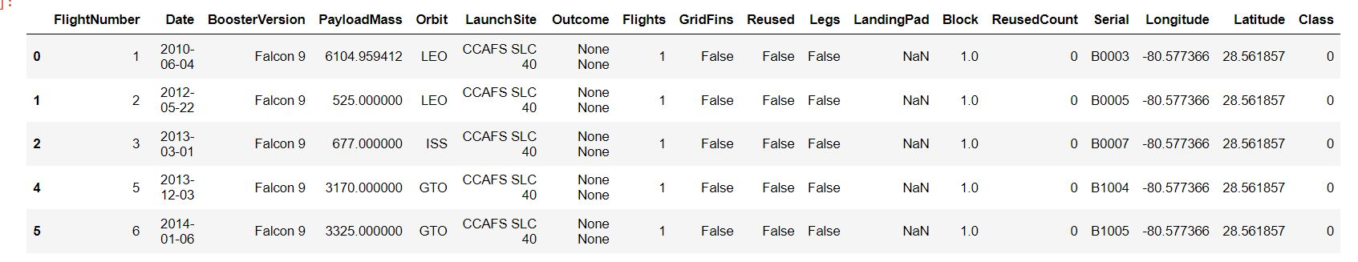
Launch Site Names Begin with 'CCA'
The 5 records where the Launch site begin with ‘CCA’

Slide 26

Total Payload Mass
Total Payload Mass carried by boosters

Slide 27
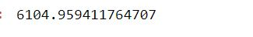
Average Payload Mass by F9 v1.1
Average payload mass carried by booster version F9 v1.1

Slide 28

Date of the first successful landing outcome on ground pad
First Successful Ground Landing Date

Slide 29
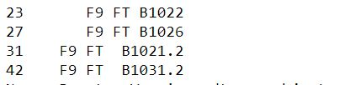
Successful Drone Ship Landing with Payload between 4000 and 6000
Names of boosters which have successfully landed on drone ship and had payload mass greater than 4000 but less than 6000

Slide 30
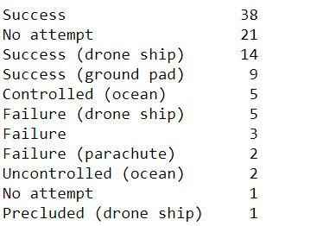
Total Number of Successful and Failure Mission Outcomes
Total number of successful and failure mission outcomes.

Slide 31
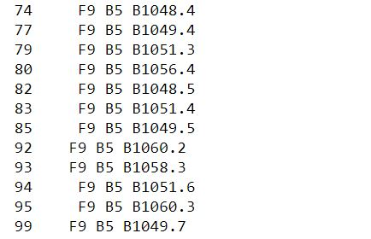
Boosters Carried Maximum Payload
Names of the booster which have carried the maximum payload mass

Slide 32
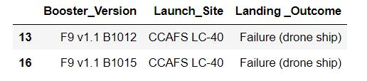
2015 Launch Records
The list of failed landing_outcomes in drone ship, their booster versions, and launch site names for in year 2015

Slide 33
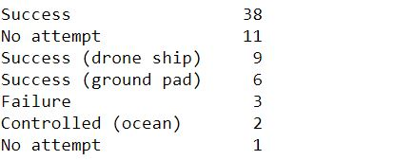
Rank Landing Outcomes Between 2010-06-04 and 2017-03-20
The Rank of the count of landing outcomes (such as Failure (drone ship) or Success (ground pad)) between the date 2010-06-04 and 2017-03-20, in descending order

Slide 34


Slide 35
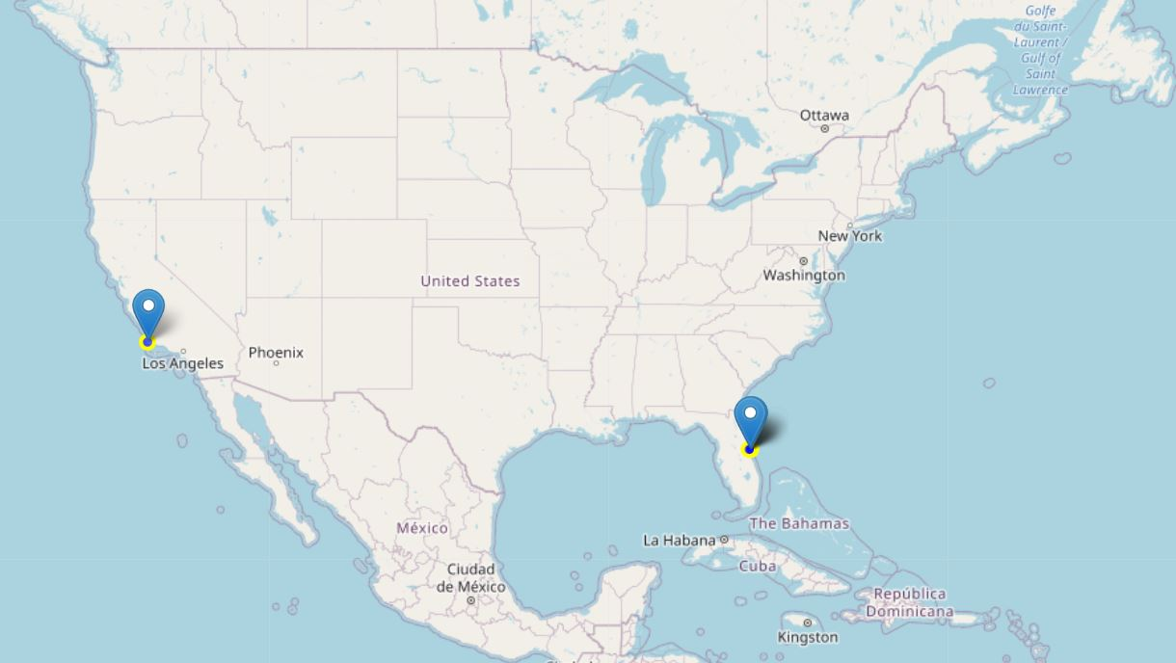
Launch Sites
Explore the generated folium map and make a proper screenshot to include all launch sites’ location markers on a global map
We find that both the launch sites are very close to the coastal plane

Slide 36
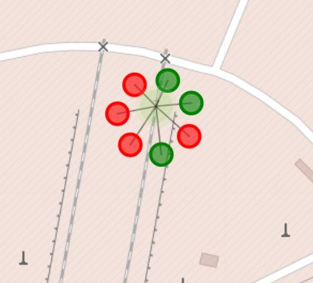
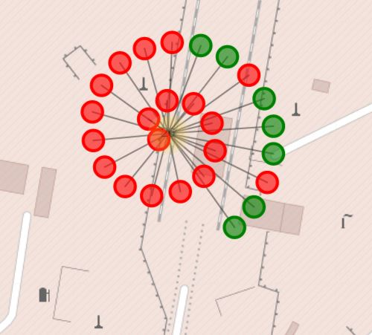
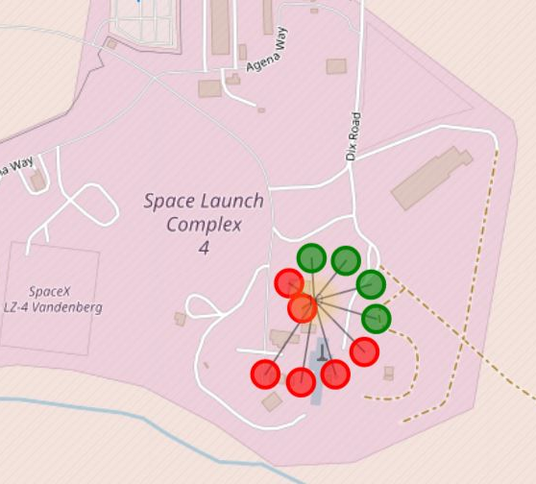
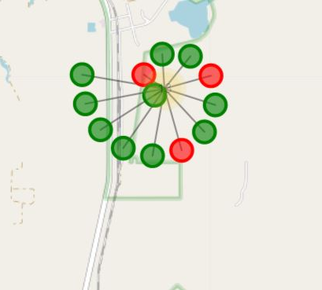
Launch sites along with Outcomes
The folium map with color coded outcomes.

Slide 37
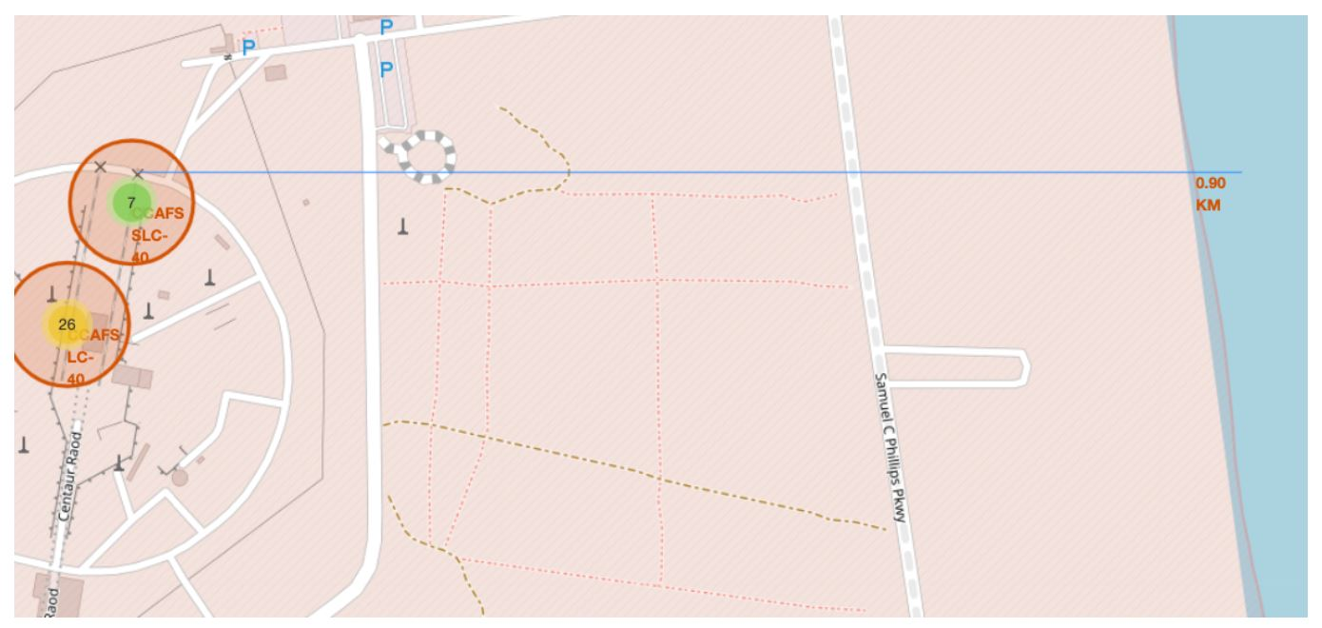
Folium Map with Proximity line
The following graph shows the distance between launch site and neaest railway station

Slide 38


Slide 39
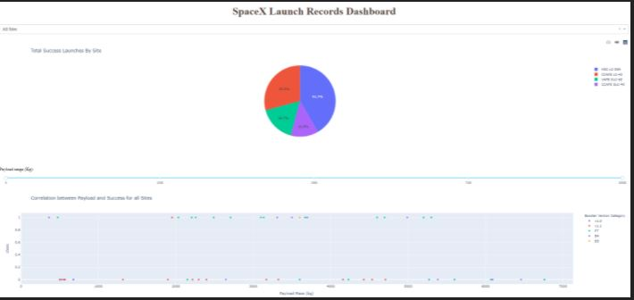
Interactive Dashboard

Slide 40

Interactive DashBoard

Slide 41
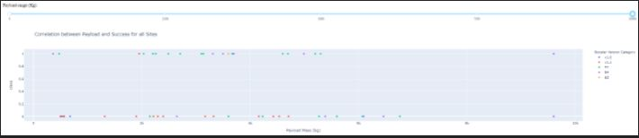
Interactive Dashboard

Slide 42


Slide 43
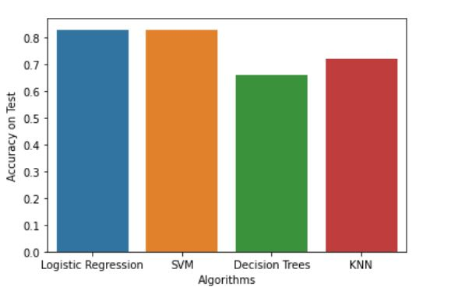
Classification Accuracy
We find that Logistic regression and SVM have the highest accuracy.

Slide 44
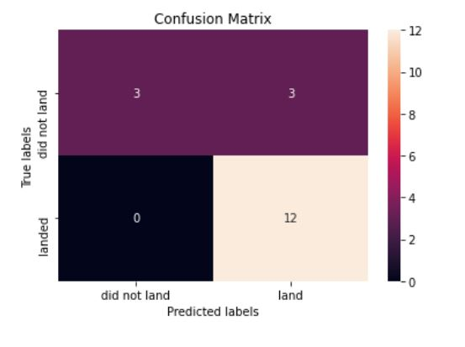
Confusion Matrix
Confusion Matrix for Support Vector Machines.

Slide 45
Conclusions
We find that SVM is the best classifier.
All launch sites are near coastal Region
The success rate of landing has increased from 2013
Rockets with a high payload mass has a higher chance of successful outcome.
GTO is the most unfavorable orbit

Slide 46
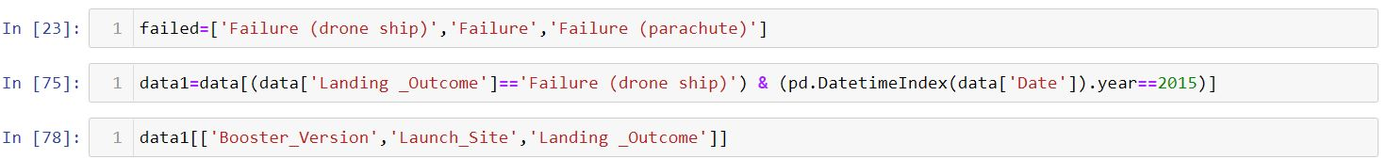

Appendix

Slide 47


